Slide 1
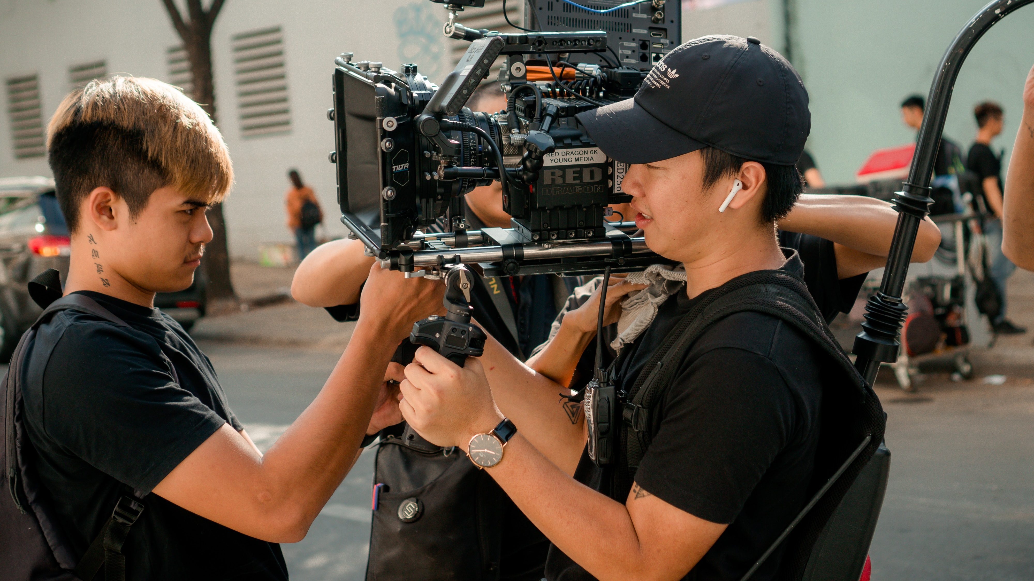
COMPREHENSIVE PRESENTATION OF THE CAMERAMAN
IN MEDIA PRODUCTION
LUKA CIGALE

Slide 2
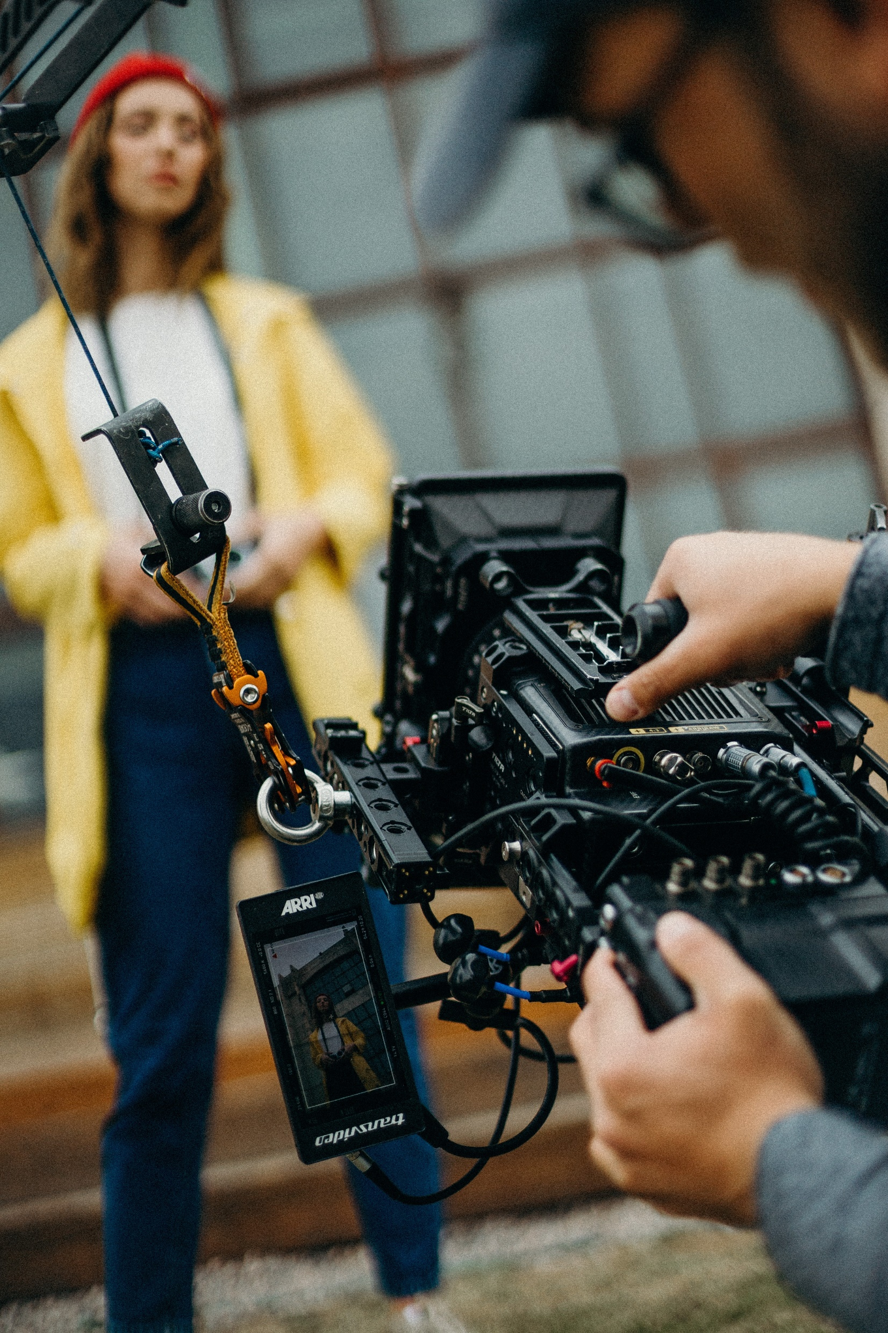
COMPREHENSIVE PRESENTATION OF THE CAMERAMAN
Video technique
The word "video" means I see
digital capture,
recording,
processing,
storage,
playback
and reconstruction of the image.

Slide 3
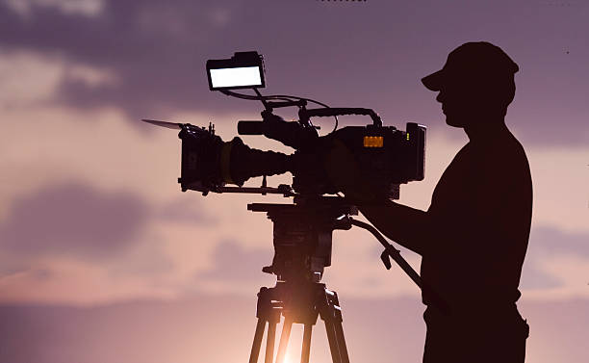
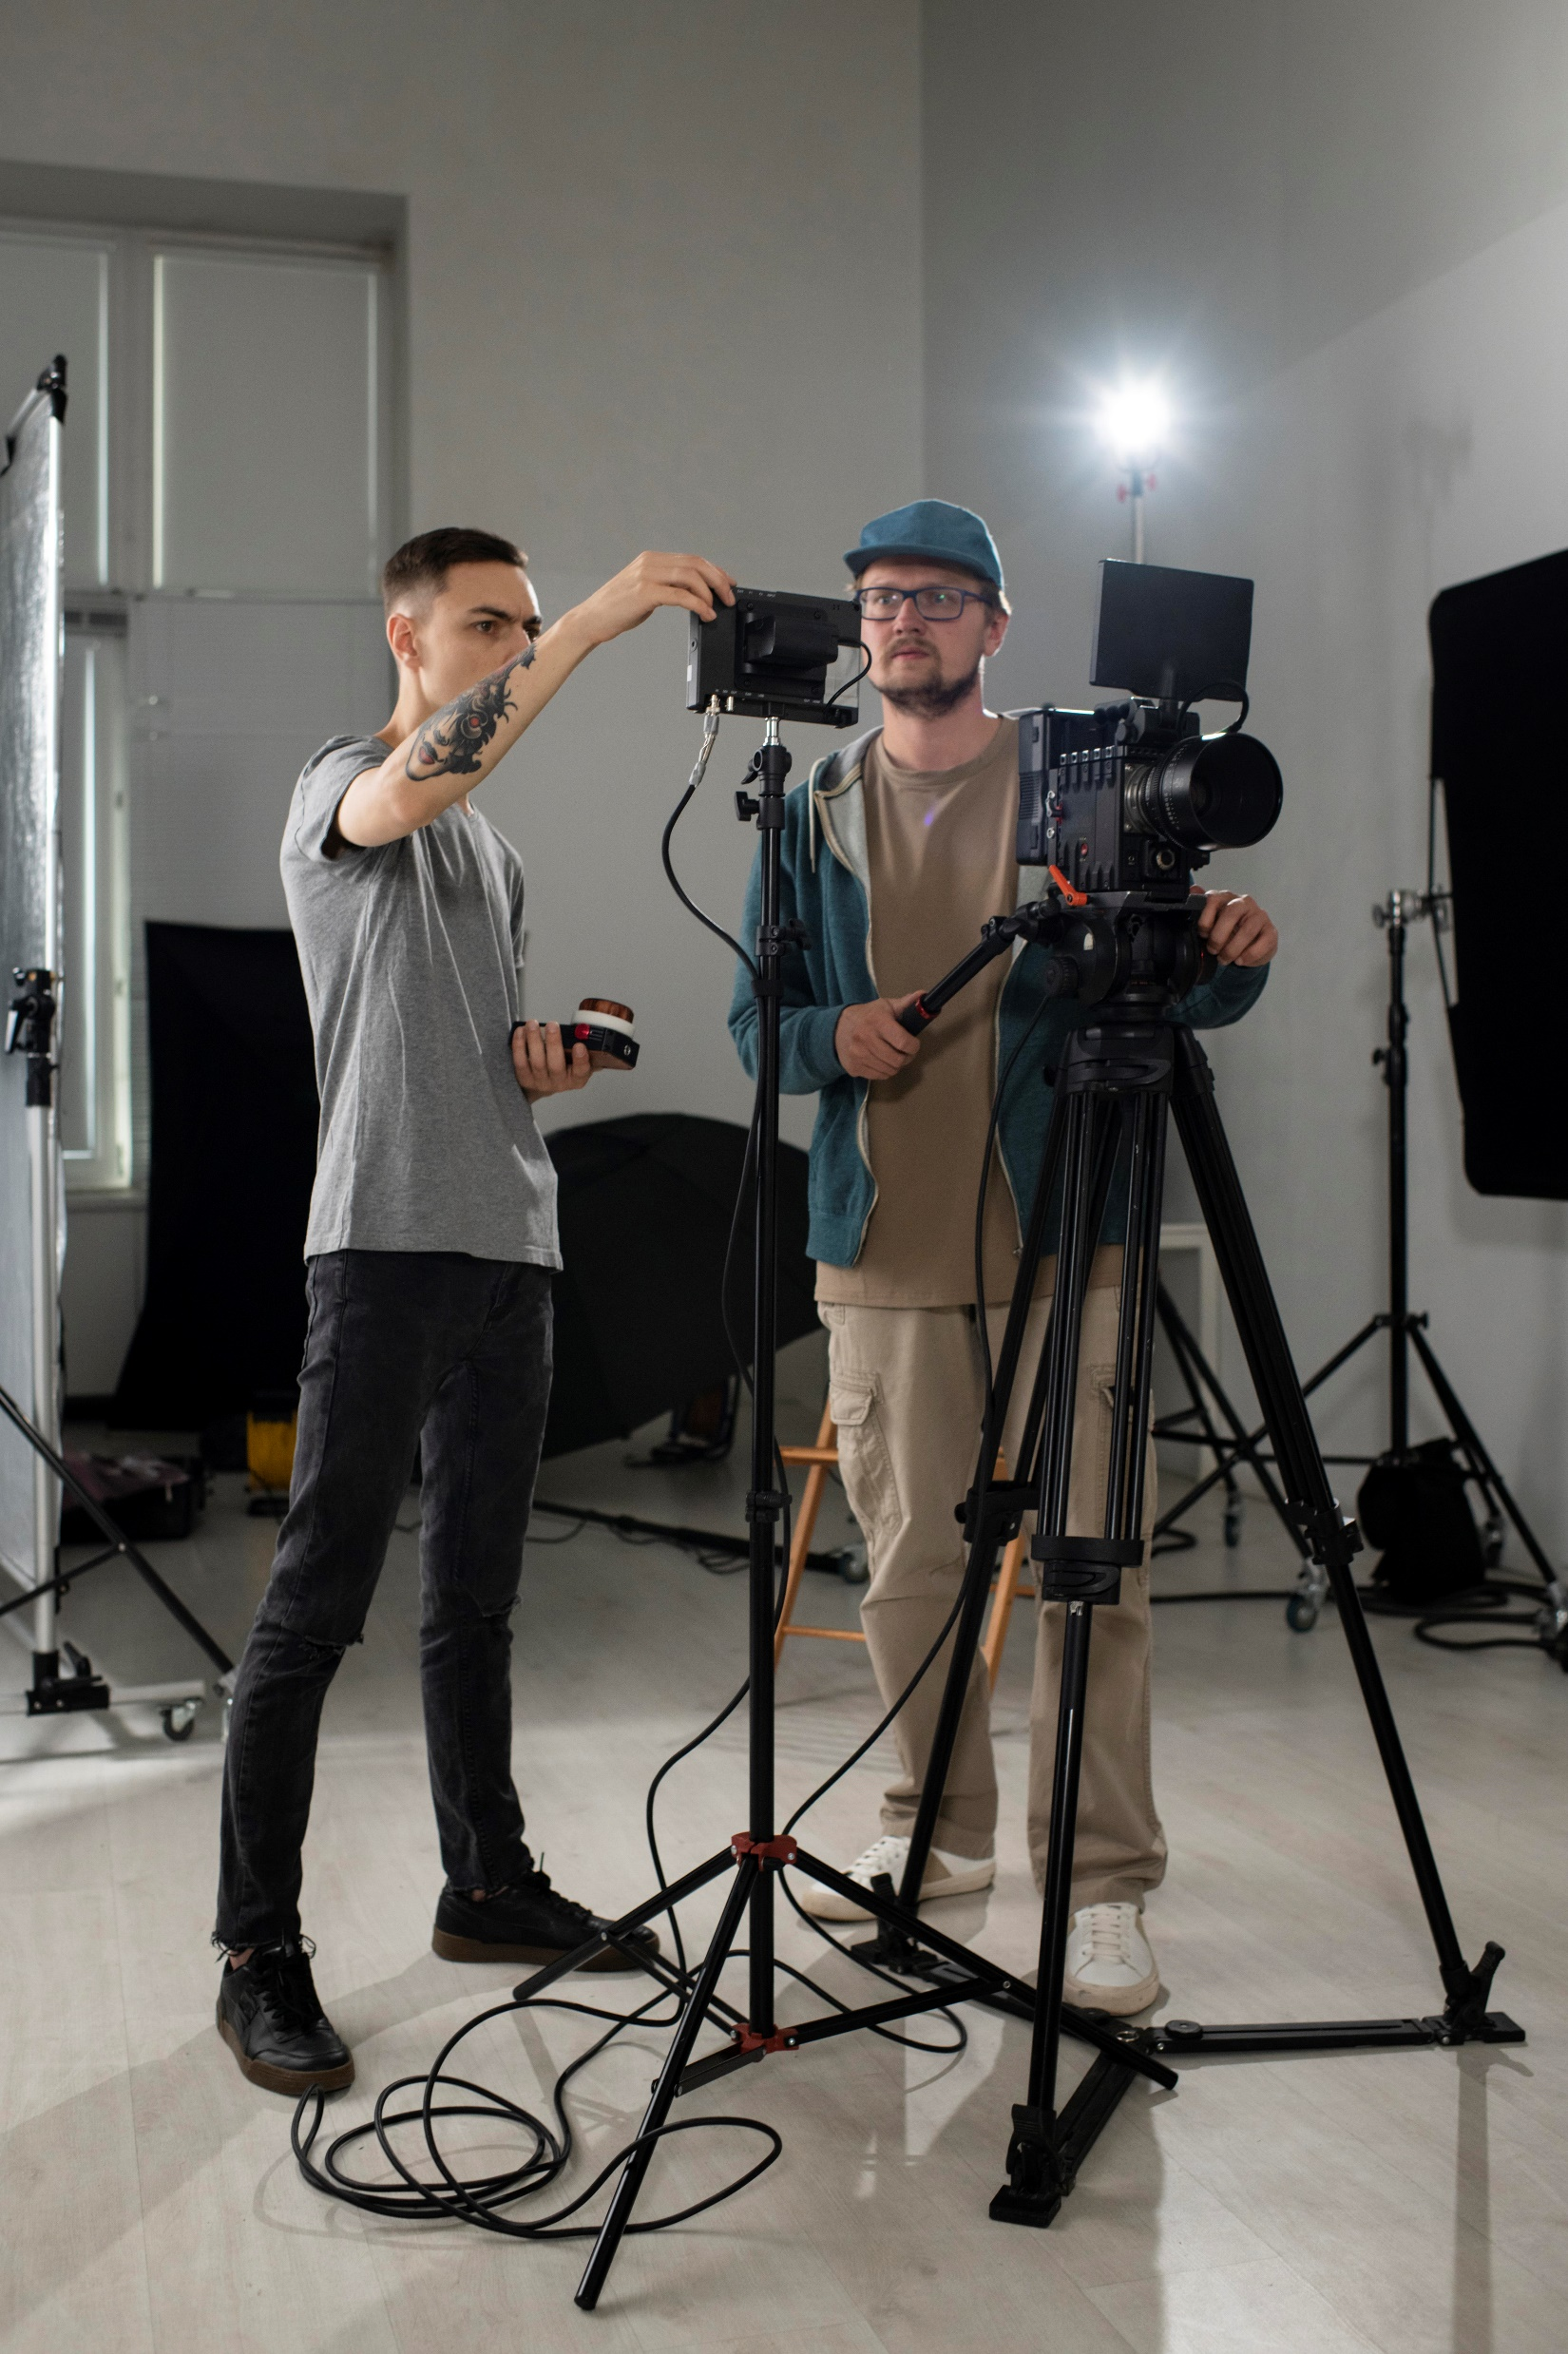
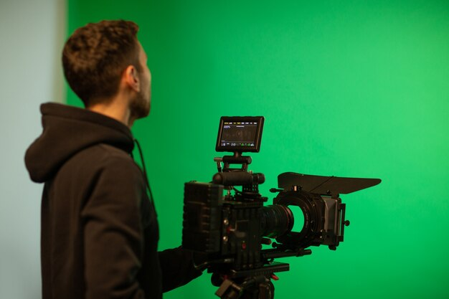
COMPREHENSIVE PRESENTATION OF THE CAMERAMAN
Cameraman
cameraman…
takes movie pictures
operates a video camera
is a member in media production
he coordinates with the director and the team

Slide 4
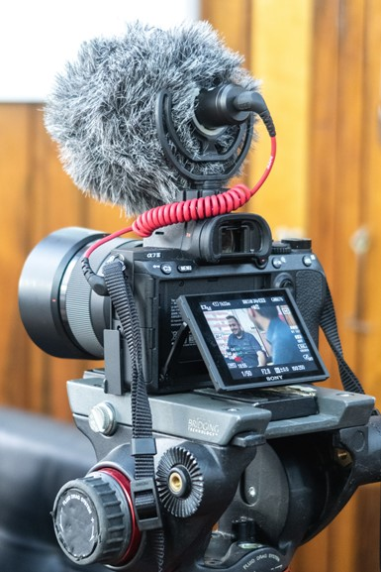

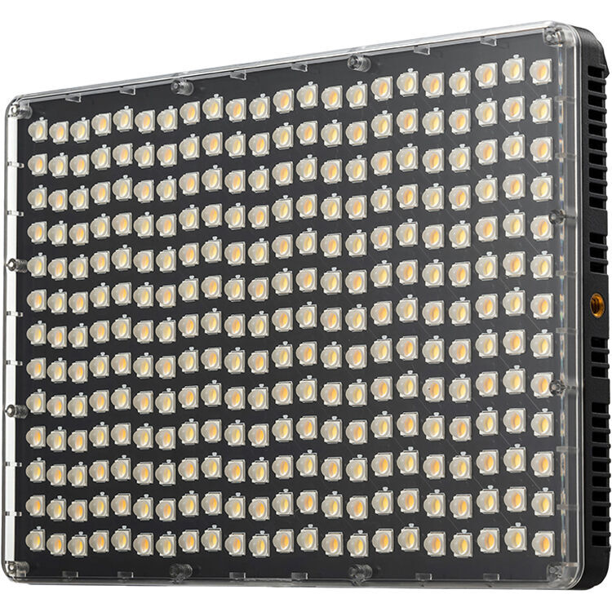
COMPREHENSIVE PRESENTATION OF THE CAMERAMAN
His equipment
Basic equipment
recording camera
tripod
memory card
battery
microphone
LED light

Slide 5
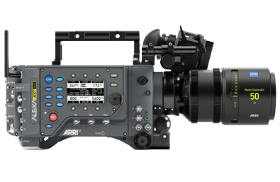
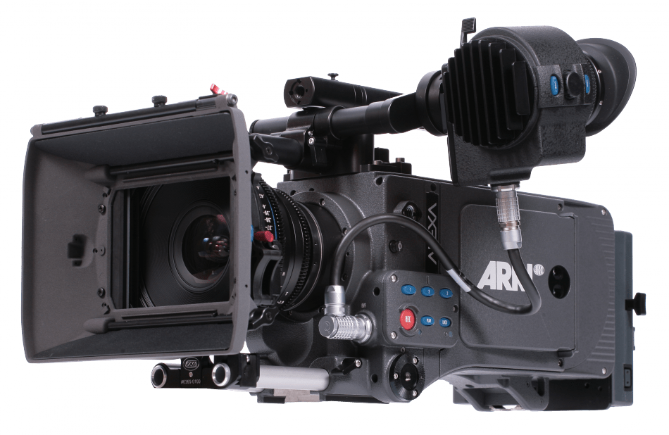
COMPREHENSIVE PRESENTATION OF THE CAMERAMAN
Types of cameras
portable camera
remote control camera
digital camera
analog camera
…

Slide 6
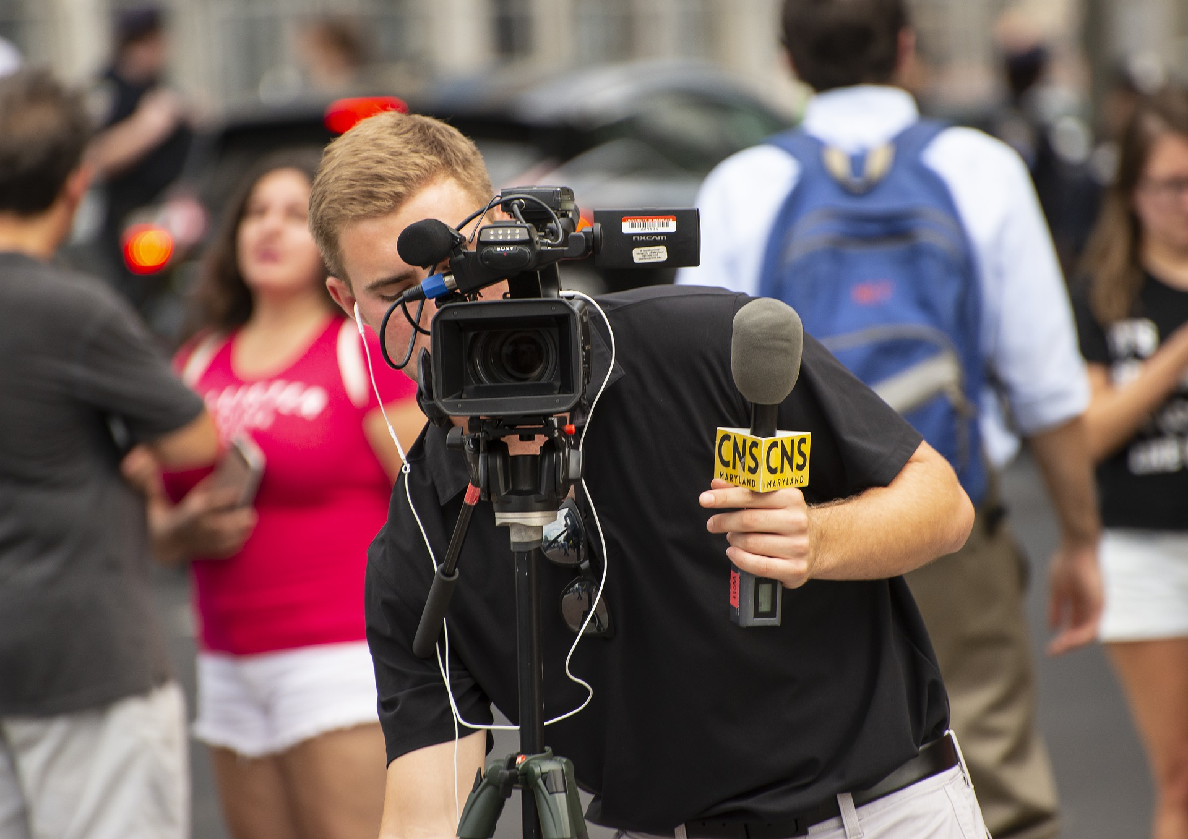
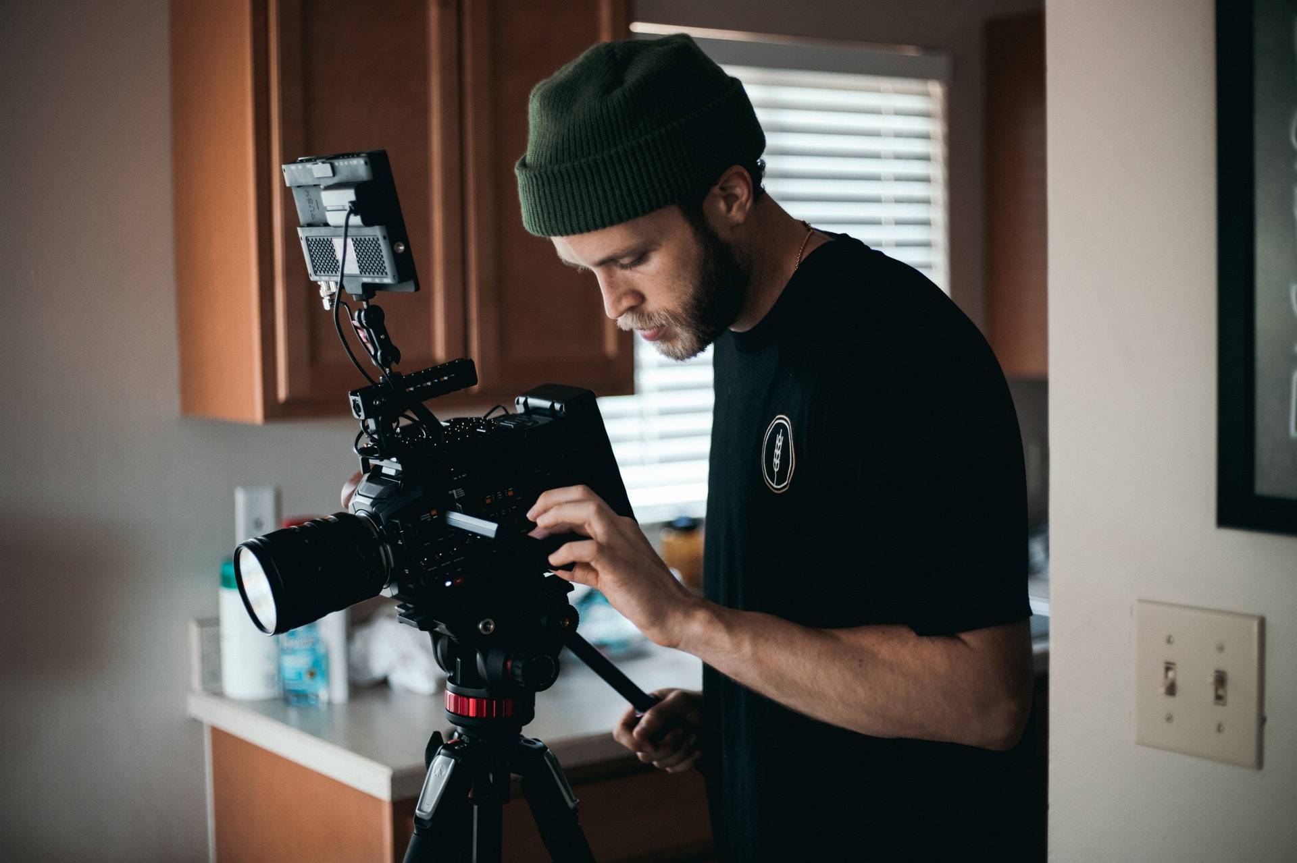
COMPREHENSIVE PRESENTATION OF THE CAMERAMAN
What does he do?
determine the vision of the production
selects the appropriate equipment
assembles and sets up equipment
follows the script
works with the lighting and technical team
captures a scene according to the director’s vision

Slide 7
COMPREHENSIVE PRESENTATION OF THE CAMERAMAN
Difference?
Artistic camerman | Camerman who records live
does not do live broadcasts | records live
artistic profession | must be responsive
can record the same events multiple times | has no time to think
makes movies, news, reports,… | connected by the headset to the director

Slide 8
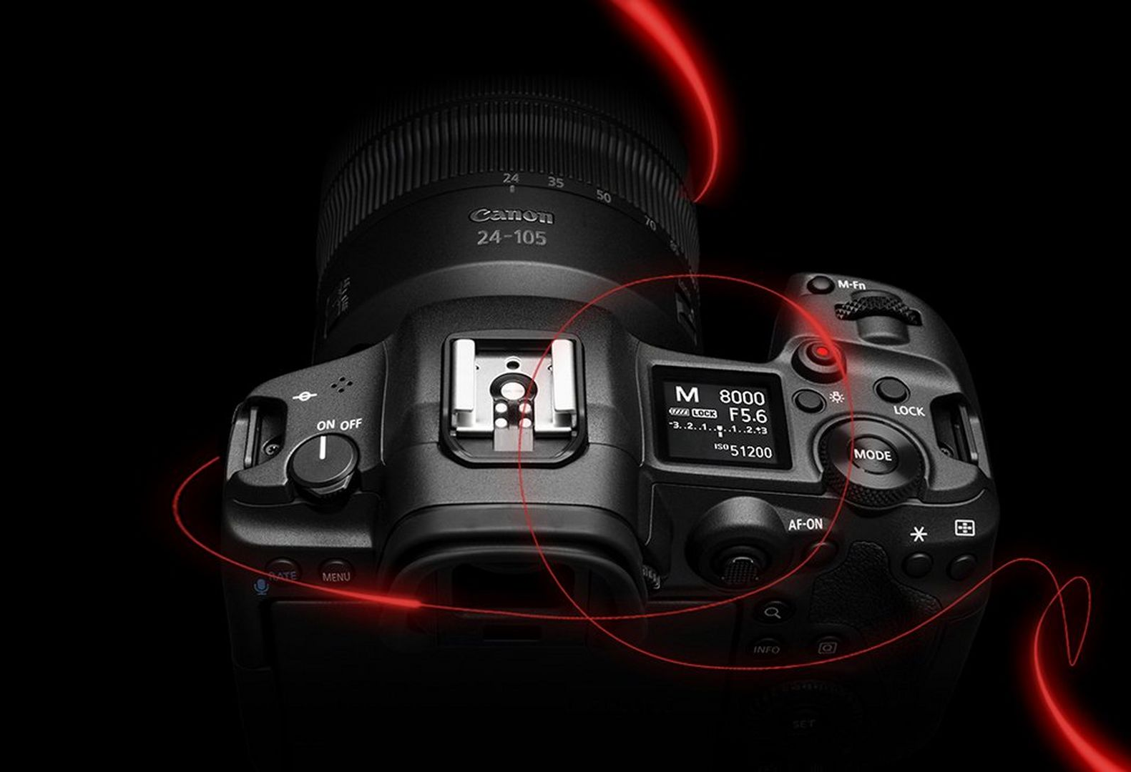
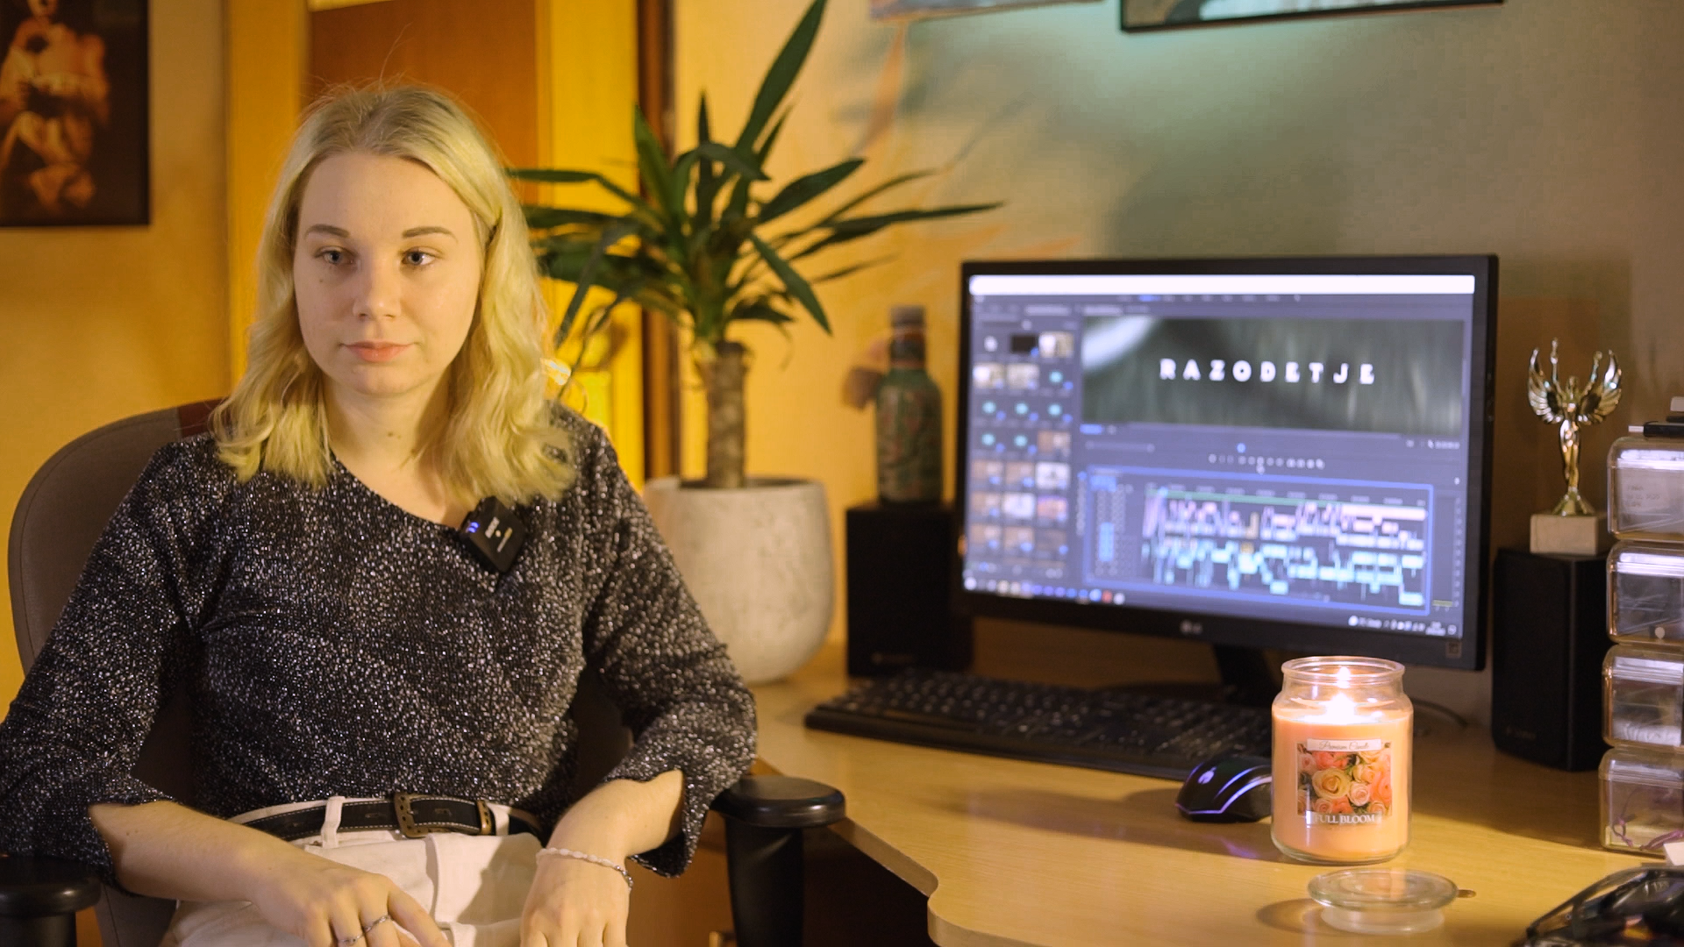
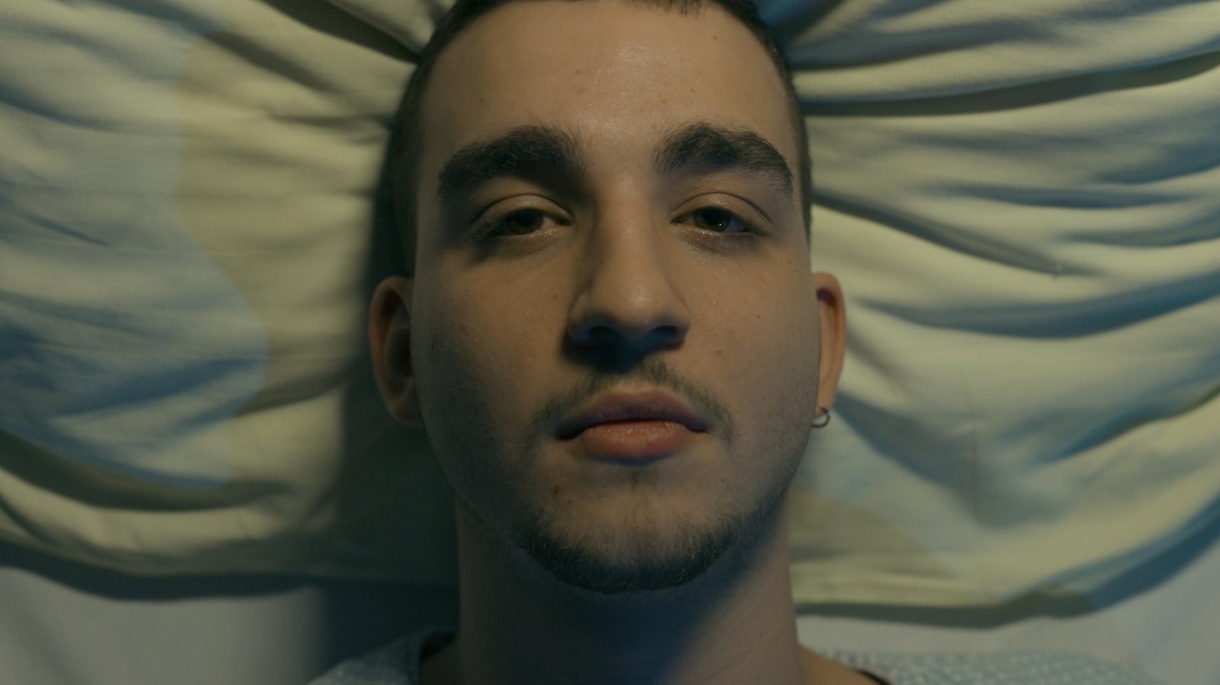
COMPREHENSIVE PRESENTATION OF THE CAMERAMAN
Practical part

Slide 9



COMPREHENSIVE PRESENTATION OF THE CAMERAMAN
Idea
Promotion of the movie Epiphany
Recorded an interview with director Sara
Video production is easy

Slide 10
COMPREHENSIVE PRESENTATION OF THE CAMERAMAN
PRE-PRODUCTION, PRODUCTION, POST-PRODUCTION
writing a synopsis and script
assigned interesting questions that would interest the audience

Slide 11
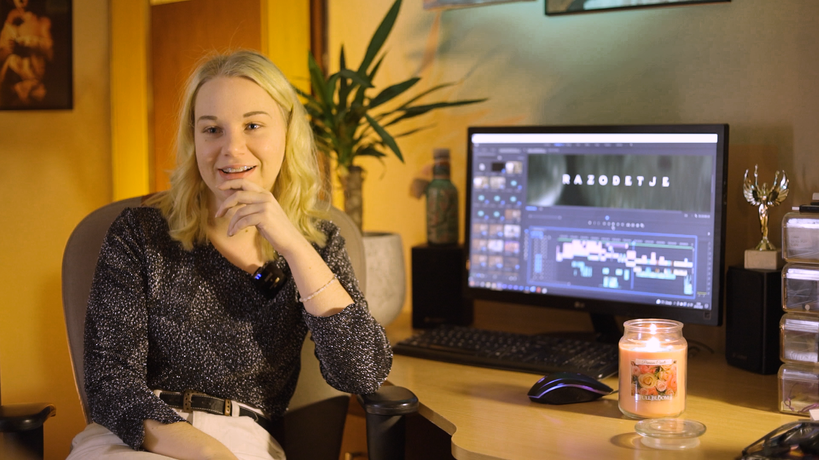
COMPREHENSIVE PRESENTATION OF THE CAMERAMAN
PRE-PRODUCTION, PRODUCTION, POST-PRODUCTION
some equipment is mine, some is borrowed
EQUIPMENT:
Canon camera
microphone
1 x LED light
1 x softbox
1x spotlight
color filters

Slide 13
COMPREHENSIVE PRESENTATION OF THE CAMERAMAN
PRE-PRODUCTION, PRODUCTION, POST-PRODUCTION
Filming → took 1 day
Scene → 1 day before
location: Sara‘s house

Slide 14
COMPREHENSIVE PRESENTATION OF THE CAMERAMAN
PRE-PRODUCTION, PRODUCTION, POST-PRODUCTION
I edited the video myself
video editing program:
  Adobe Premiere Pro

Slide 15
COMPREHENSIVE PRESENTATION OF THE CAMERAMAN
Conclusion
satisfied with the film
exceeded my expectations and goals
I learned a lot of new things
PROBLEMS:
recording may be delayed
forgetting text and appropriate words
unfocused video
composition choice
…

Slide 16
Thank you for your attention!
Link

