Slide 1
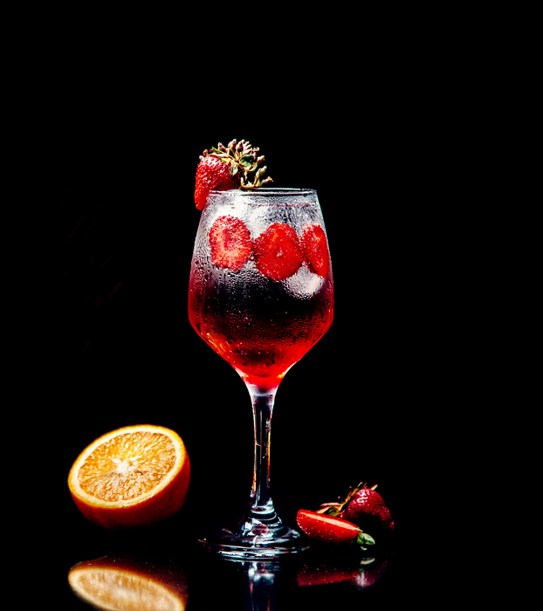

Online appearance strategy
Luka Cigale,
24. 3. 2022
Notes:
Hello, I will present you the strategy of online appearance for my company Cocktail Club.

Slide 2

content marketing
A technique that combines the creation and sharing of useful content,
the purpose of gaining potential customers and loyal customers
2
Notes:
Content marketing is a technique in which we combine the creation and sharing of useful content in order to attract a certain audience and prepare them to cooperate in a certain field. In doing so, we must strive for the goal that its purpose is to gain a lot of potential and loyal customers who will bring us profit later.

Slide 3
Social network
landing page
e-mail with e-handbook
e-handbook
3
Notes:
So, I made a e-handbook, which I then advertised on Facebook. The post on Facebook contained a link to the Landing page, where readers left their email address, and I then sent them an email with an e-handbook.

Slide 4
purpose
It helps high school and university students from 18 to 27 to get acquainted with our idea,
encourages you to visit our club,
increased sales of our services / promotional products,
the content is intended for a specific population,
methods of notification:
    email,
    blog,
    videos,
    publications (FB, IG),
    magazines,…
4
Notes:
The purpose of content marketing is to expand the visibility of our company and increase sales of our service. We can design it in several ways. Some of the ways can be: emails, blogs, various videos, posts on social networks (Facebook, Instagram, Twitter, magazines,…)

Slide 5
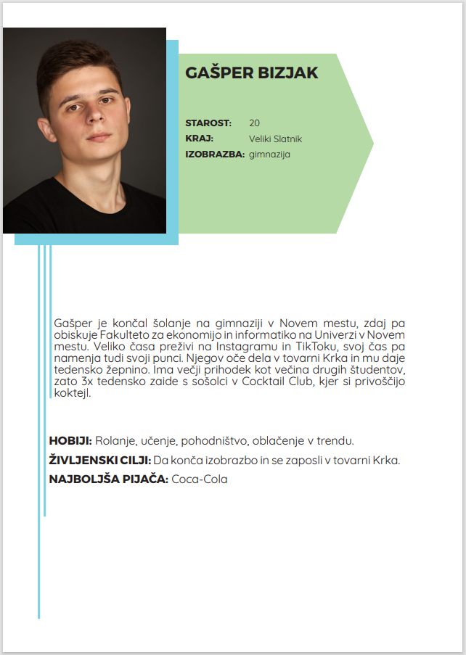
TARGET POPULATION
Persona = ideal customer,
fictional person, real data,
Gašper Bizjak (20 years)
    They drink cocktails 3 times a week with friends
5
Notes:
In order to start the campaign, I had to determine its target population (persona). Persona represents the person who is the ideal customer for our sales products. In my case, this is 20-year-old Gašper, who is attending the Faculty of Economics and Informatics in Novo mesto. He and his classmates go to the Cocktail Club 3 times a week to enjoy cocktails.

Slide 6

e-handbook
Presented 3 most popular recipes,
created in the online program Canva,
content:
  short story,
  3 recipes,
  company logo,
  company information.
6
Notes:
I started the e-mail campaign by creating an e-handbook in which I present the three most popular cocktail recipes. I created it in the Canva web editor and added a short story that attracts the customer to view the e-handbook, the company logo and company information with a link to the website.

Slide 7
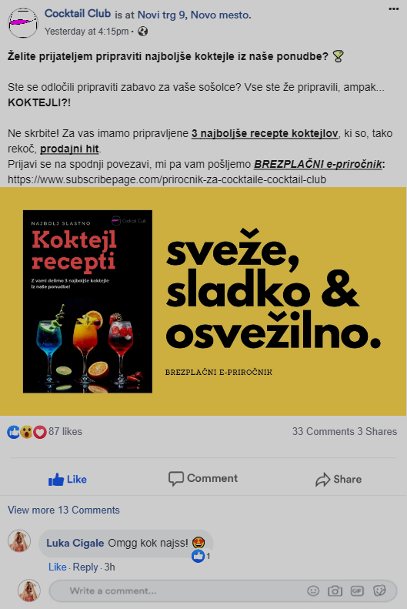
bait
collection of e-mail addresses,
Facebook post ➔ Click on the landing page ➔ Email entry ➔ Email guide
content of the publication:
    short motivational words,
    solution (recipes),
    photo for attention,
    link to landing page.
7
Notes:
In order to be able to send the email e-handbook to the customer’s email address, I had to create a bait. With it, I posted a post on Facebook urging customers to get a free e-handbook if they click on the link that takes them to the landing page. In a Facebook post, I wrote short motivational words that will entice the reader to click on the link and leave their email address. So I obtained their e-mail address and then included it among the recipients of the e-handbook.

Slide 8
LANDING PAGE
through it we obtain e-mail addresses for sending notifications,
content:
    photo of the e-handbook,
    striking inscription "Fresh, sweet & refreshing."
    contact acquisition field.
8
Notes:
The landing page is a key element, as I obtained e-mail addresses through it to send the e-handbook. Now I can send them various promotions, interesting facts about the company, price changes or inform them about our new sales.
In the landing page, I also added a photo of the e-handbook and a short striking caption "Fresh, sweet & refreshing."
LANDING PAGE ➔

Slide 9
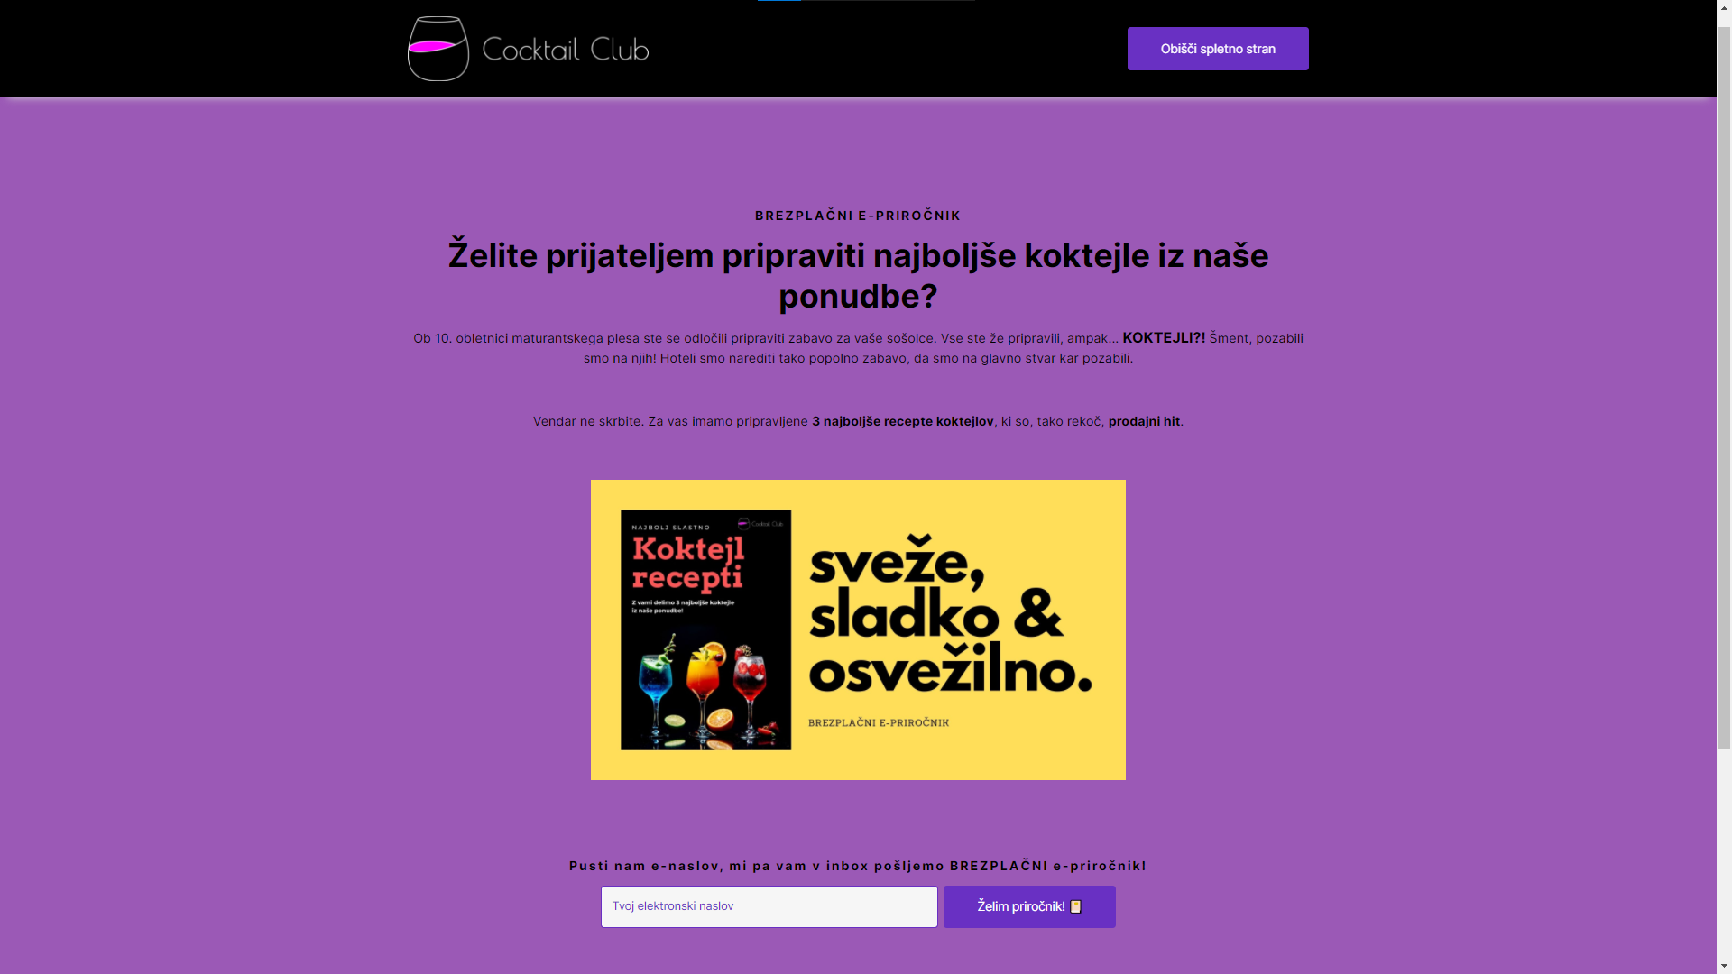

Slide 10
e-mail action
produced in MailerLite
    I created the "e-handbook" group,
write a subject
created an e-mail campaign with a template.
10
Notes:
I started creating an e-mail campaign by first reviewing the contact database, which I obtained through the Landing page.
I created content marketing in the online program MailerLite, which also allowed me to create a group ‚e-handbook', to which I could send it to everyone at once just by clicking on this group. Before sending the e-mail, I had to write the subject of the e-mail and create an e-mail campaign with the template.
EMAIL RECEIVED ➔

Slide 11
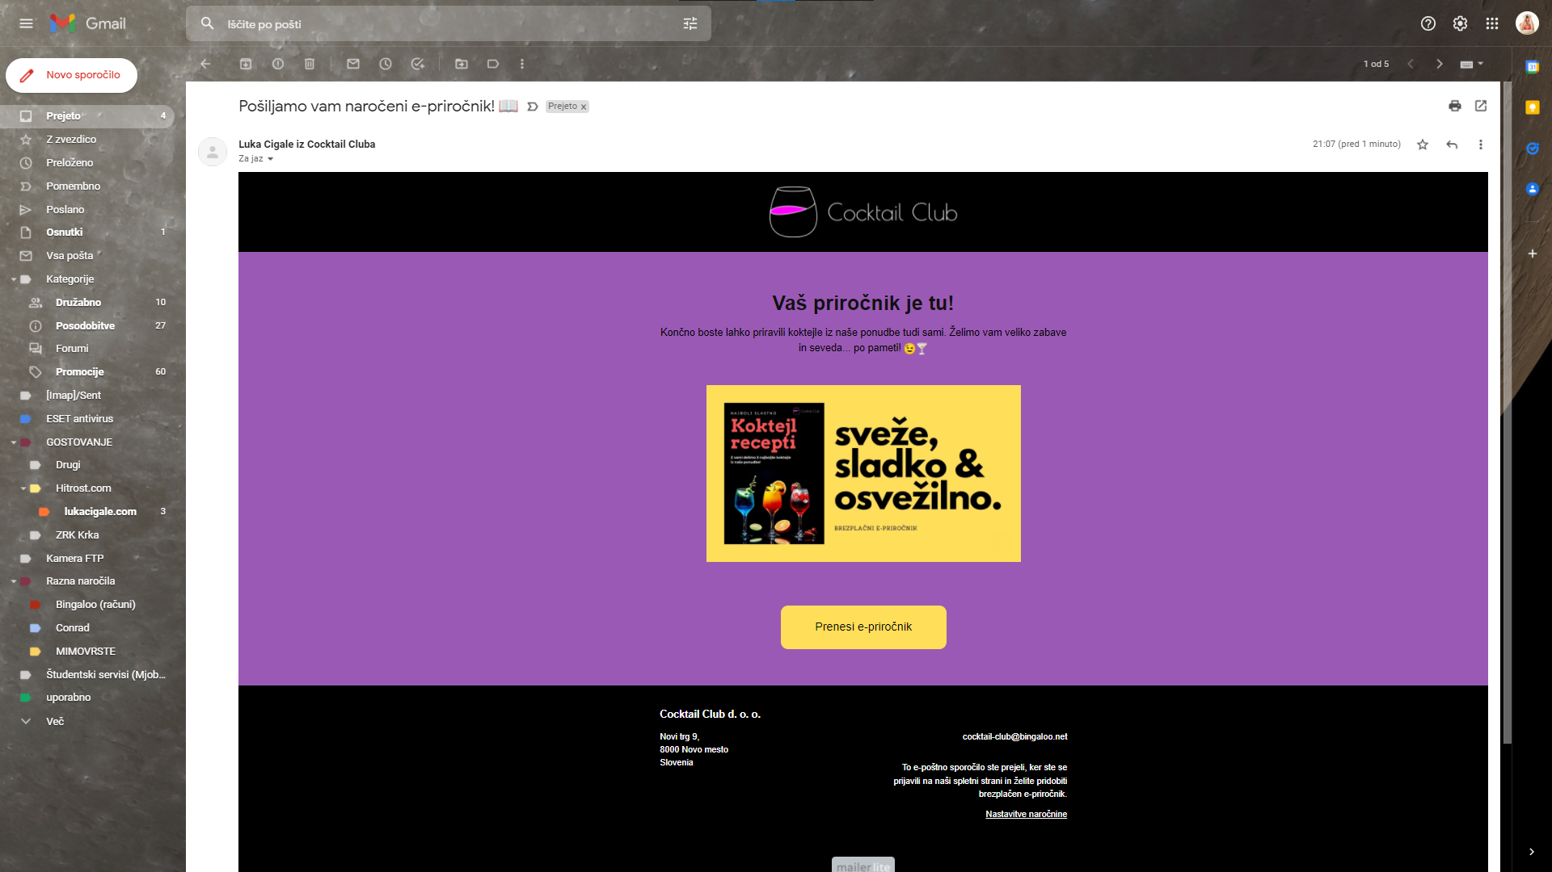

Slide 12
Thank you for your attention
Notes:
Just one sales campaign will not lead the customer to buy, so you need to send more campaigns at certain intervals, such as a campaign with benefits, a campaign with discounts (22% on promotional T-shirts) and the like.
Thank you for your attention.

